Slide 1

MEBIS CITY
https://prezi.com/p/2puq67eeoy9f/

Slide 2
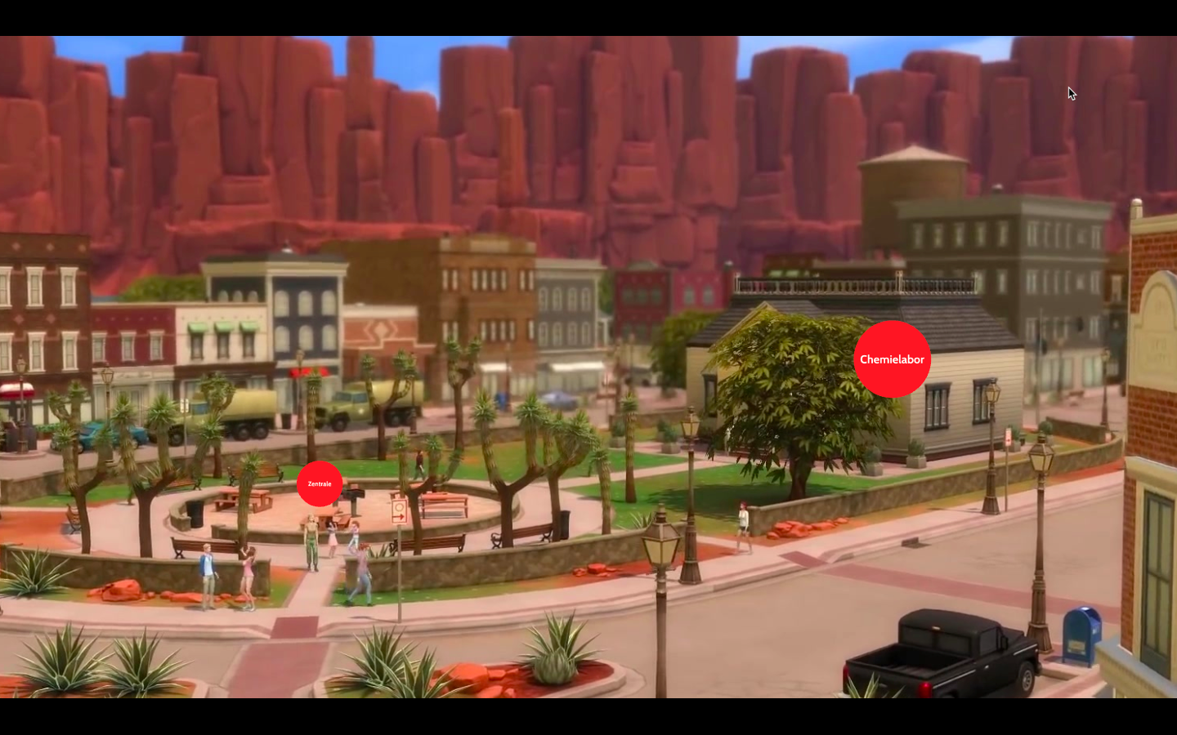

Slide 3
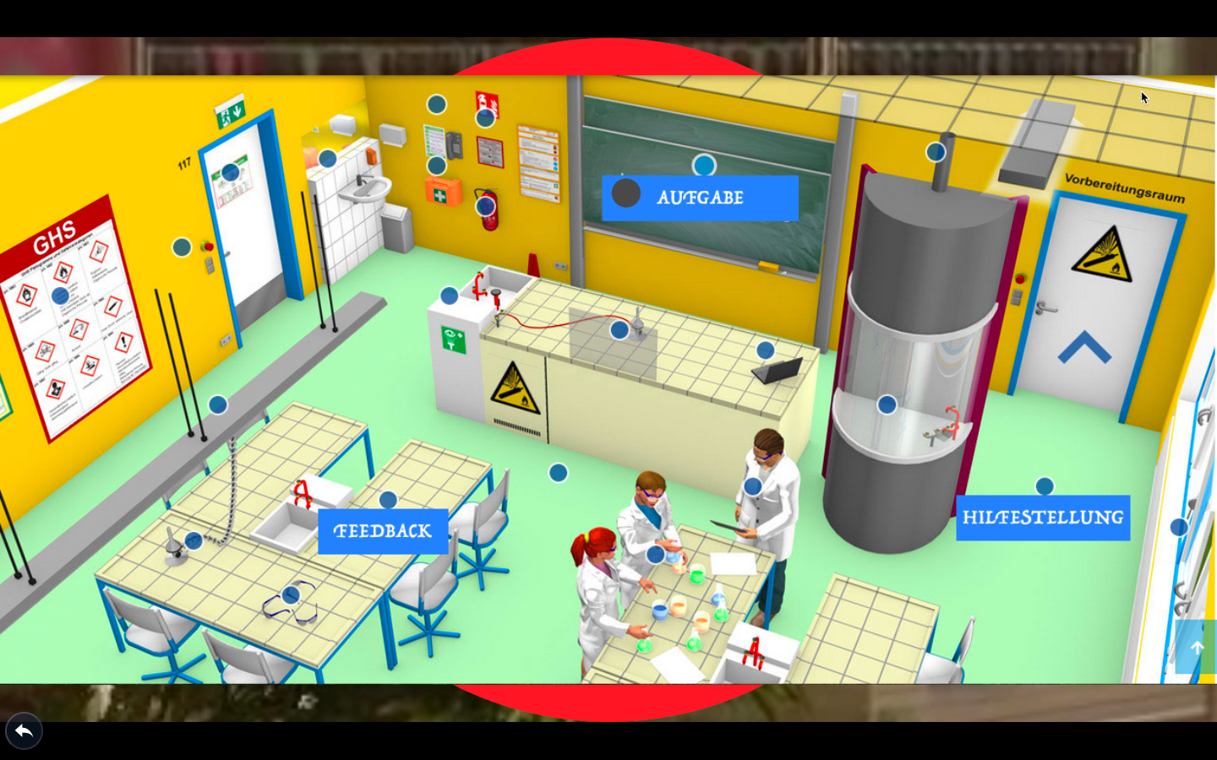

Slide 4


Slide 6
